Slide 1
Regional Competitive & Expansion Analysis​
By: Deepika Udhani

Slide 2
Agenda
Market Analysis​
Expansion Strategy
Strategic Partnership​
Cost Cutting Measures​
Financial Analysis​
Appendix

Slide 3
SWOT Analysis
WRITE YOUR SUBTITLE HERE
External Opportunities (O) ​
Implementation of other languages​
2. Capture highly more skilled employees​
3. Expansion into other regions​
4. Expansion globally
External Threats (T) ​
High cost associated with expansion​
2. Potential failure with expansion​
3. Growth in AI industry​
4. Free language resources (YouTube; Kahn Academy)​
5. Reliance on Cloud Service ​
6. Hostile takeover
SO Strategic Options​
Leverage strength to seize opportunity​
​
1. Focus on innovation and content creation​
2. Establish strong connections and build brand awareness through strategic partnerships​
3. Attracting skilled labor from local talent pool
ST Strategic Options​
Leverage strength to mitigate threat​
​
1. Leverage low supplier reliance to minimize high cost of expansion​
2. Provide better customer service and content quality to overcome free subscription services​
3. Leverage benefit of work at one's own pace
Internal Strengths (S)​
Industry Knowledge​
2. Local Connections​
3. Strategic Partnerships (YMCA)​
4. Low Supplier Reliance ​
5. Low Cost for Employees​
6. Customer work pace control​
7. Providing Certifications
WO Strategic Options​
Seize opportunity to overcome weakness​
​
1. Retaining skilled employees to gain edge on the market​
2. Increase in customer base by expanding globally & in other languages​
3. Strengthening brand awareness & recognition due to expansion
WT Strategic Options​
Play defense to overcome weakness and mitigate threat​
​
1. License and copyright content to local municipalities and schools​
2. Strategic partnerships to tailor content to specific group​
3. Less reliance on AI land cloud services leading to lower maintenance cost​
Internal Weaknesses (W)​
Many Competitors​
2. Low barriers to entry​
3. High reliance on customers​
4. Brand Awareness and Recognition​
5. Low Customer Base​
6. Cost for maintaining the Cloud Services

Slide 4
Market Analysis
Spanish Language Growth
Spanish Speaker in the US
English Learning 10-year CAGR
By 2050 1 out of 3 people in the US will speak Spanish
53M (13%)
8.5%
Product Differentiation
Global Language Learning Market
Client can differentiate on cost
A lot of alternatives for lower prices, but in larger markets
Client has a competitive advantage by selling in smaller markets
$59.60B
$191.06B
2021 Market Size
Expected 2030 Market Size
6 Competitors
Current Offerings
Important Considerations
Open English
Duolingo
Rosetta Stone
Babbel
Speexx
ELSA Speak
Online Course (English)
Translation
Spanish Tutoring
French Tutoring
Majority of growth will be from APAC
There is a distinction between learning English for business and learning English for personal reasons

Slide 5

Expansion Timeline
Five Year Strategy
Expand to other cities within Indiana and establish company presence
Target cities with predominate Spanish population
Ten Year Strategy
Expand into neighboring states of Indiana
Target cities with strong Spanish population within Midwest states
Build and develop relationships with local municipalities, churches, and other public services

Slide 6
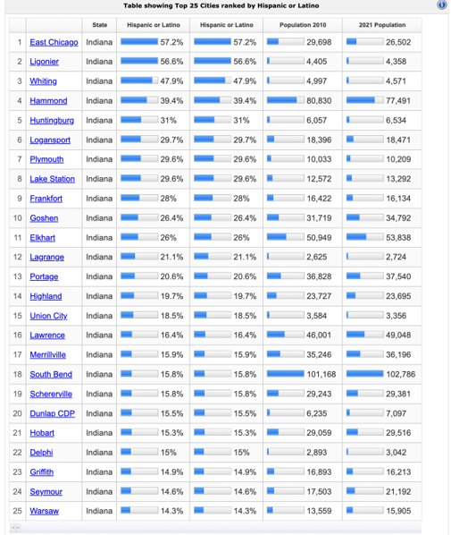
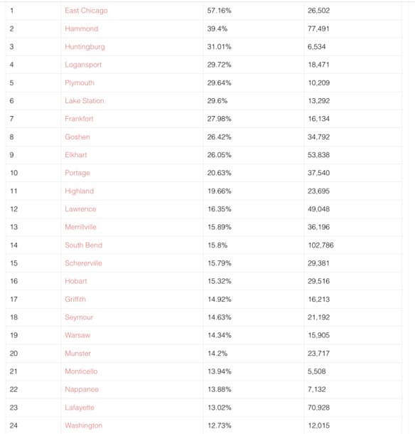
Hispanic Population Within Indiana

Slide 7
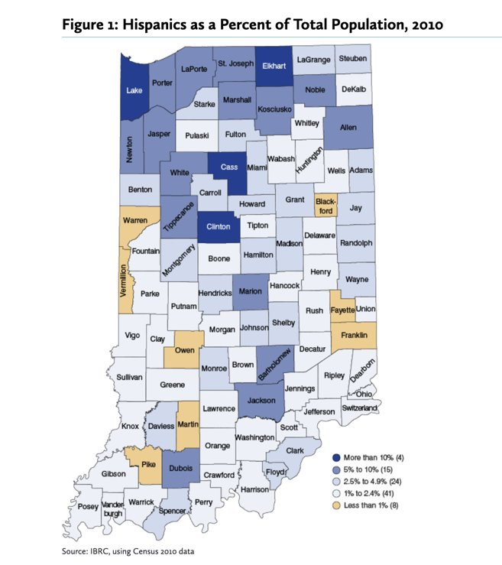
Expansion Strategy: Indiana
East Chicago (Indiana), Hammond, Huntingburg, Logansport, and Plymouth, Lake Station

Slide 8
Expansion Strategy
Married Couple
Householder Not Living Alone
Single Mother
Living Alone
Single Father

Slide 9
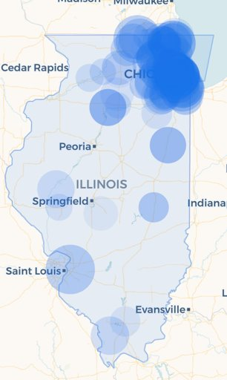
Midwest Expansion
#
CITIES
%
1
Stone Park, IL
90.1%
2
Cicero, IL
87.7%
3
Melrose Park, IL
78.0%
4
Park City, IL
75.9%
Illinois Hispanic population represents 18% of total population within Illinois
5
Summit, IL
75.2%
6
Fairmont City, IL
71.9%
7
Chemnung, IL
69.8%
8
Posen, IL
65.4%
9
Stickney, IL
64.0%
10
De Pue, IL
63.3%

Slide 10
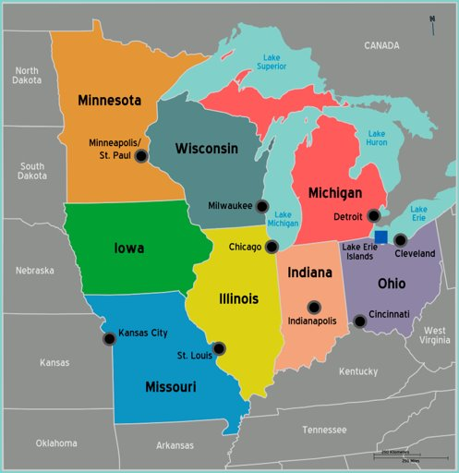
Midwest states to Target
Ohio: 505K; 4.2% of total population
Illinois: 2.191mil; 18% of total population
Michigan: 521K; 5.6% of total population
Wisconsion: 408K; 7.5% of total population

Slide 11
Strategic Partnership
Employment in Leisure & Hospitality
Arts, Entertainment & Recreation
Accommodation & Food Service
Top 5 Hotel Chain
Corporate
Corporate DEI
Corporate Tech Companies

Slide 12
Financial Analysis
Old Balance Sheet
Equity
Restated
Opening Balance Equity
$ 1,071
Equity
Owners Pay & Personal Expense
$ -92,202
Opening Balance Equity
$ 1,071
Retained Earnings
$ 109,197
Retained Earnings
$ 48,117
Net Income
$ 31,122
Total Equity
$ 49,188
Total Equity
$ 49,188

Slide 13
Financial Analysis
Financial Ratios
Cash Management
167
Current Cash
$ 43,318
Liquidity Ratio
Current Ratio
Operating Cash
$ 3,088
Excess Cash
$ 40,231
Proposed Short Term Investment
$ 20,000
Invest in Expansion
$ 20,231
Profitability Ratio
57.9%
Profit Margin

Slide 14
Questions?

